Slide 1
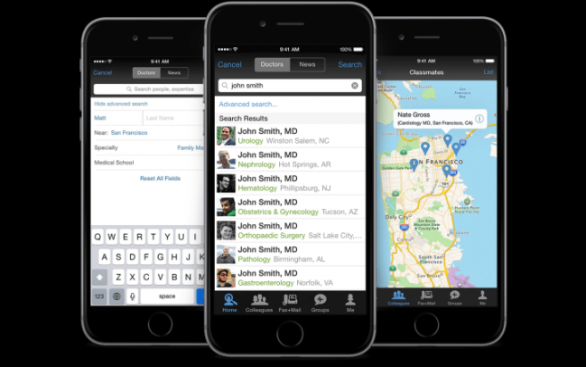
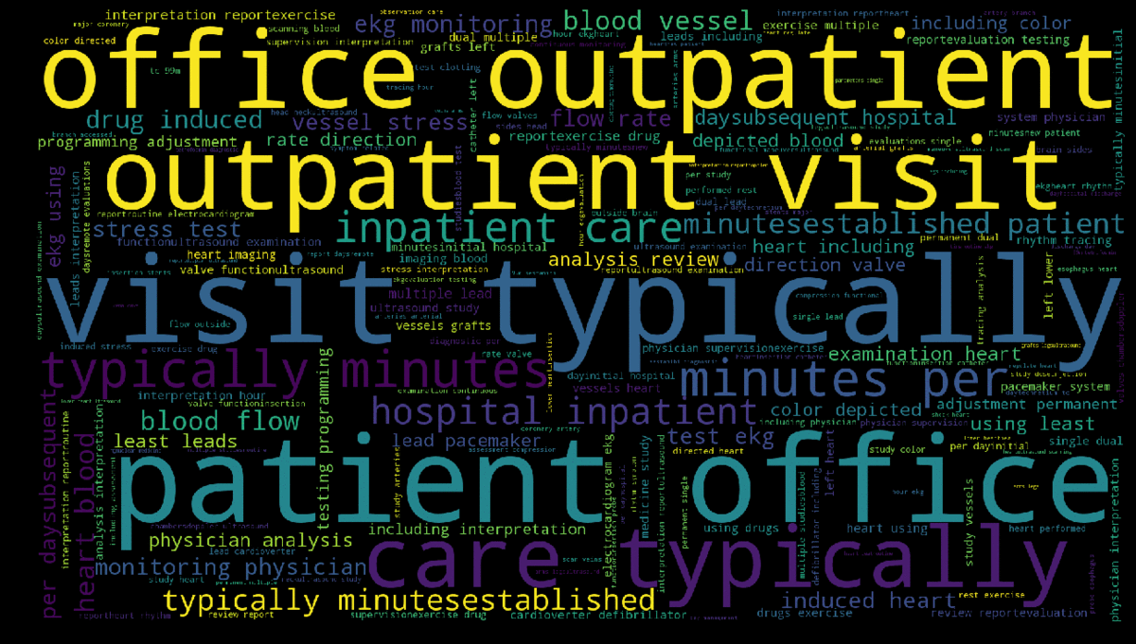
DocReach
Predicting Physician Specialty from Text Data
Sushil Sharma - Galvanize Cohort#65
Capstone Project – May’2018
Linkedin: https://www.linkedin.com/in/krishnatray
Github: https://www.github.com/krishnatray

Slide 2


Business Problem
Marketing Campaign
e.g. News Feed, Adv.
Sarah
Marketing Manager

Slide 3
Business Problem
Marketing Campaign
e.g. News Feed, Adv.
Sarah
Marketing Manager

Slide 4
Business Problem - Summary
A large social media marketing firm wants to target doctors / physicians based on their practice area.
Example: A marketing campaign to target Cardiologists for heart related news feed.

Slide 5
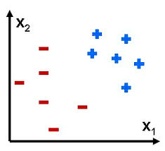
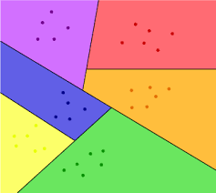
Project Scope
1
2
Predict cardiologists vs Non-Cardiologists
Multiclass classifier to predict top 5 specialties

Slide 6
Data Source(s)
procedures.csv - contains a list of procedures doctors performed over the past year. The columns of this dataset are as follows:
physician_id unique physician identifier, joins to id in physicians.csv
procedure_code unique code representing a procedure
procedure description of the procedure performed (Text Column)
number_of_patients the number of patients the doctor performed that procedure on over the past year
physicians.csv - contains a list of doctors and their unique specialty. Specialty is listed as "Unknown" for the doctors need to be classified.
physician_id unique physician identifier, joins to id in physicians.csv
Specialty String e.g. Cardiologist
Text Column
Category Column

Slide 7
Process
Data
Features
Prediction
Model
RandomForest
y = f(x)
Bag of Words
Tokenization
Cleaning (Stop words, Stemming, etc.)
Count Vector: TFIDF
Prep / EDA
Target Categories
Histograms
Data Cleaning, Nulls
Data Structure
Join
Xgboost
GradientBoosting

Slide 8

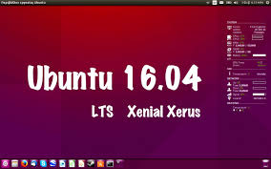
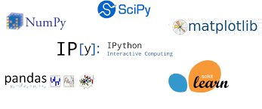


Technology Used

Slide 9
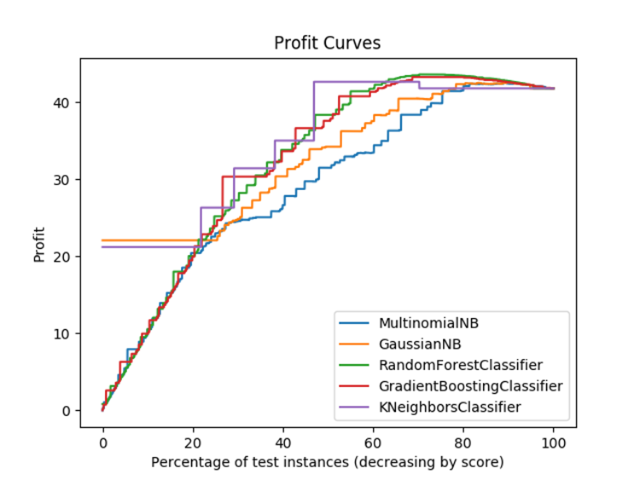
Results – Best Model (Binary)
Model Selection Method: Highest Profit
Best model: Random Forest
Accuracy Score Test: 80.5%
F1 Score : 0.81
Best threshold: 10%
Resulting profit: $43.64

Slide 10
Results: Multiclass
Model Selction Method : Highest F1 Score
Model | Accuracy | Precision | Recall | F1-Score
MultinomialNB | 0.665 | 0.67 | 0.67 | 0.66
GrBoosting | 0.698 | 0.67 | 0.70 | 0.66
RandomForest | 0.708 | 0.68 | 0.71 | 0.68
XGBoost | 0.688 | 0.65 | 0.69 | 0.65

Slide 11
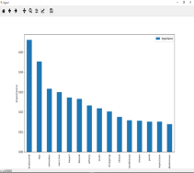
Top Features – Binary vs Multiclass
Top features – Binary Classifier
1 | heart
2 | interpretation
3 | study
4 | blood
5 | ekg
6 | report
7 | typically
8 | catheter
9 | dual
10 | ultrasound
11 | minutes
12 | hospital
13 | insertion
14 | lead
15 | outpatient
Top features – Multiclass Classifier
1 | ultrasound
2 | ray
3 | minutes
4 | vaccine
5 | heart
6 | blood
7 | artery
8 | scan
9 | imaging
10 | chest
11 | anesthesia
12 | views
13 | joint
14 | injection
15 | abdomen

Slide 12
Challenges / Learnings
Data Volume
Parameter to train on sample
AWS machine with multiple CPU
High Dimensionality
Algorithms were running Slow
Limited features to 1000
Gradient boosting is slow (Sequential)
XGBoost
No free lunch theorem
RandomForest outperfomed other algorithms (Binary classification)
SSH session timeouts / Process Monitoring
Tmux
htop

Slide 13
Next Steps / Future Plans
API / APP
Unsupervised Machine Learning
Custom Ensemble Models
Clustering, PCA, T-SNE
Model Performance
Find additional Features
Deep Learning
Explorer Deep Learning for Text Classification
Create Flask / Javascript Application /Api

Slide 14
Thanks!
Sushil Sharma
Linkedin: https://www.linkedin.com/in/krishnatray
Github: https://www.github.com/krishnatray

Slide 15
Backup slides

Slide 16
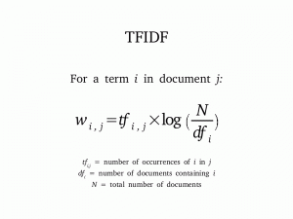

Slide 17
Data Summary
Total Instances: 406,690
Procedure length varies 6 – 256; Median 66
Binary Classes
Cardiologists 47%
Non-Cardiologist 53%
Multiclass picked top 5 and combined rest specialty as other
Cardiology 47%
Diagnostic Radiology 10%
Family Practice 7%
Internal Medicine 9%
Orthopedic Surgery 3%
Other 26%

Slide 18
Program Structure
Data
train_model.py
best_model.pkl
predict.py
New Instances
Prediction

Slide 19
Common words

Slide 20
